Slide 1

Internet of Things & Puck.js session
Innovation Office | May 2017

Slide 2

Outline
Introduction to Disruptive Innovation
Internet-of-Things (IoT)
Puck.js
Hands on

Slide 3
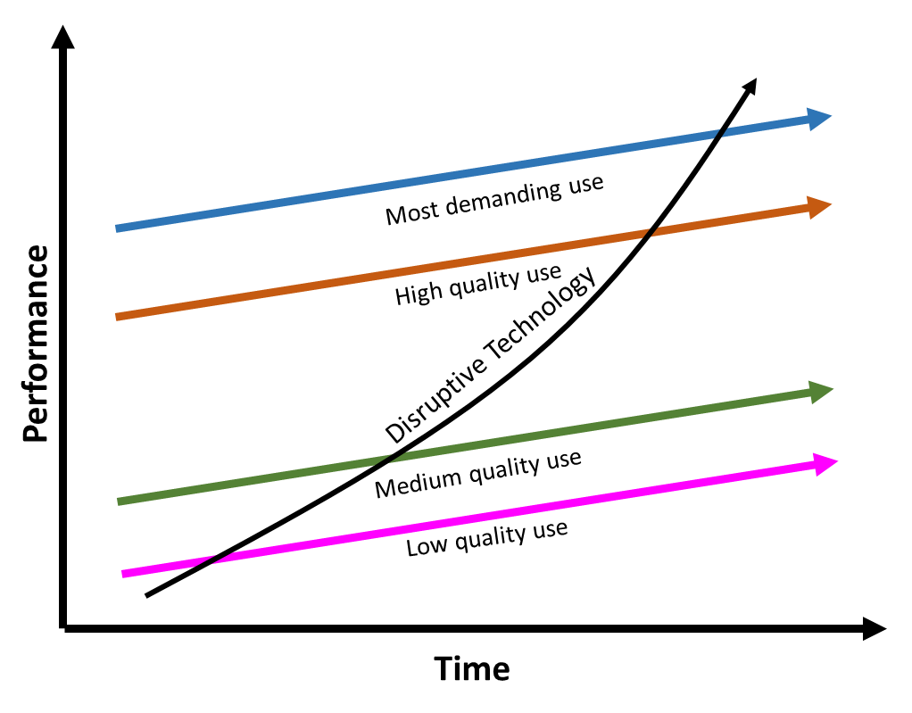

Theory of Disruptive Innovation
Sustaining Innovation. These focus on growing existing technologies by enhancing their performance, mostly through extended functionality or increased capacity.
VS
Disruptive Innovation. These change the landscape of an entire industry, or spark a new one altogether, because they solve a problem in an entirely new way or for an entirely new group of people.
Clayton Christensen

Slide 4
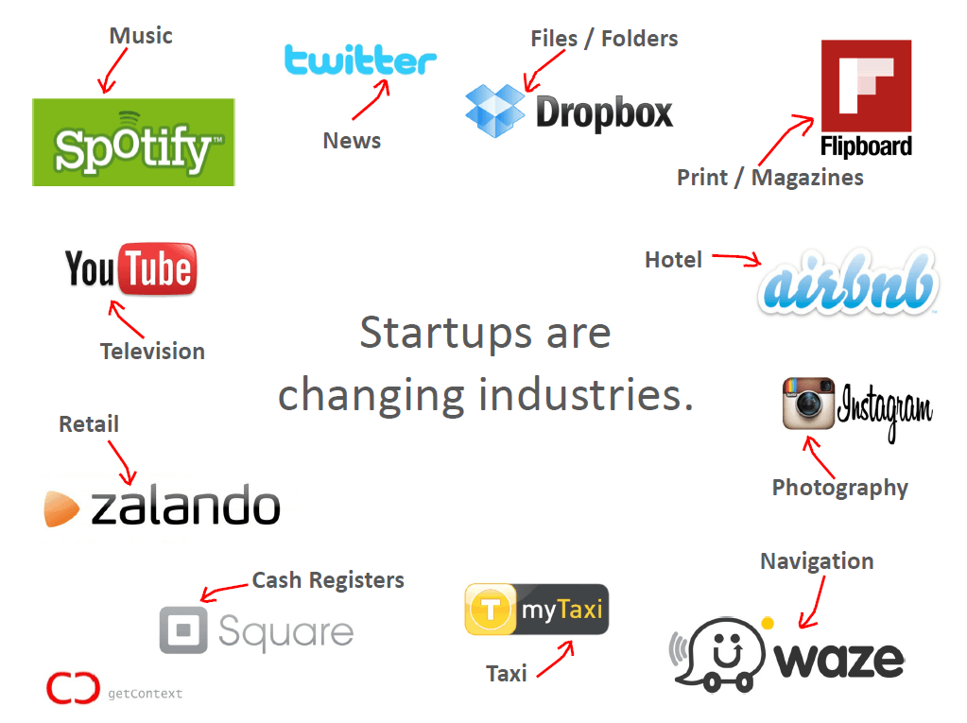
Disrupted Industries
Who’s next?

Slide 5
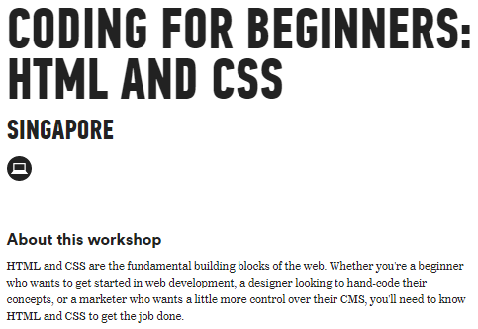
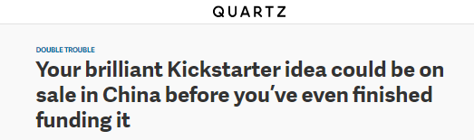
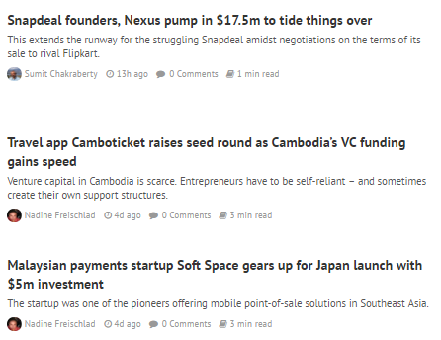
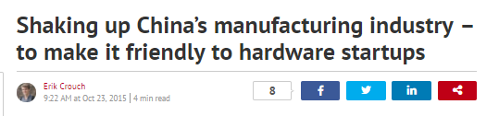
Why are industries disrupted so quickly?
Tech literacy
Low/no barriers to entry
Low manufacturing cost
Venture funding in hopes of unicorns ($1B startups)

Slide 6
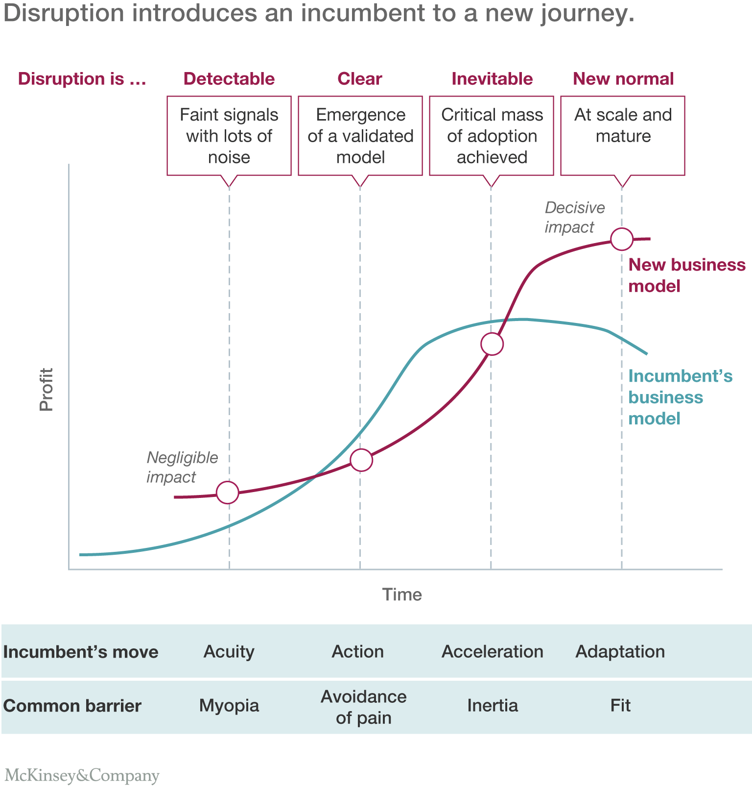
The incumbent’s journey of disruption
http://www.mckinsey.com/business-functions/strategy-and-corporate-finance/our-insights/an-incumbents-guide-to-digital-disruption

Slide 7
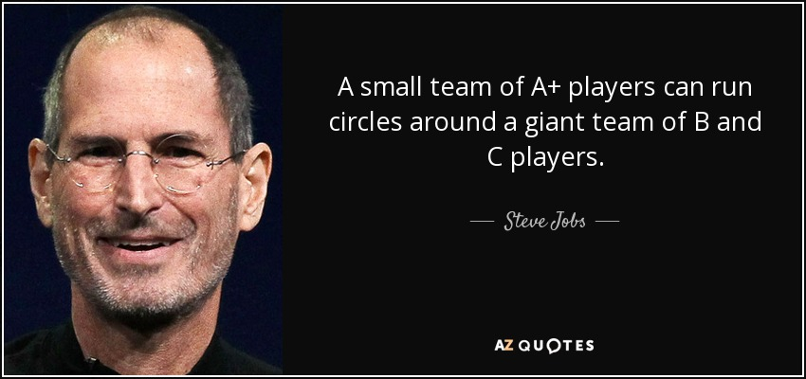
What can we do?
Think like a disruptor, act like a startup (PwC)
Embrace change (McKinsey)
Think MVP: Iterate quickly (Peter Thiel)

Slide 8
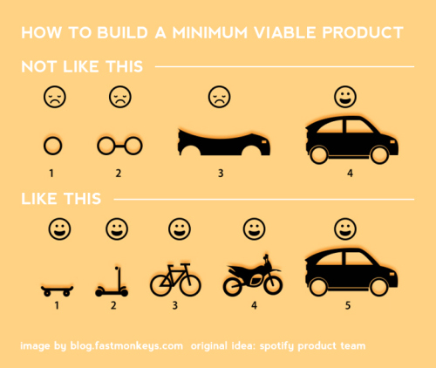
Think MVP: Minimum Viable Product

Slide 9
Learning Outcomes
Think like a disruptor
Think MVPs (Minimum Viable Product)

Slide 10
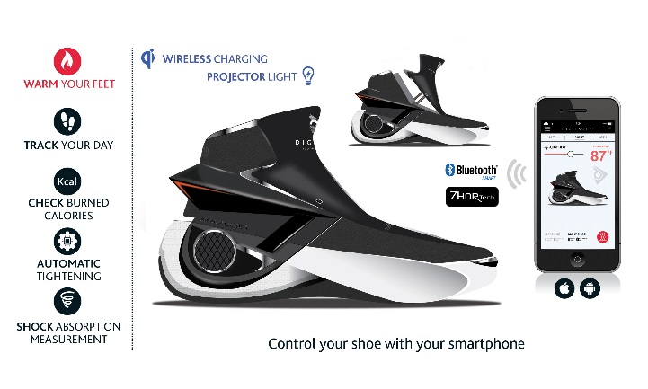
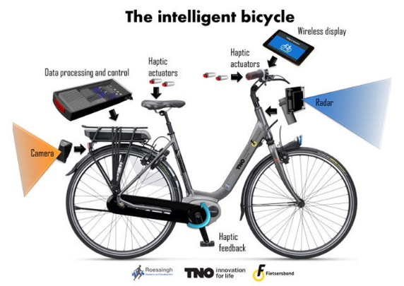
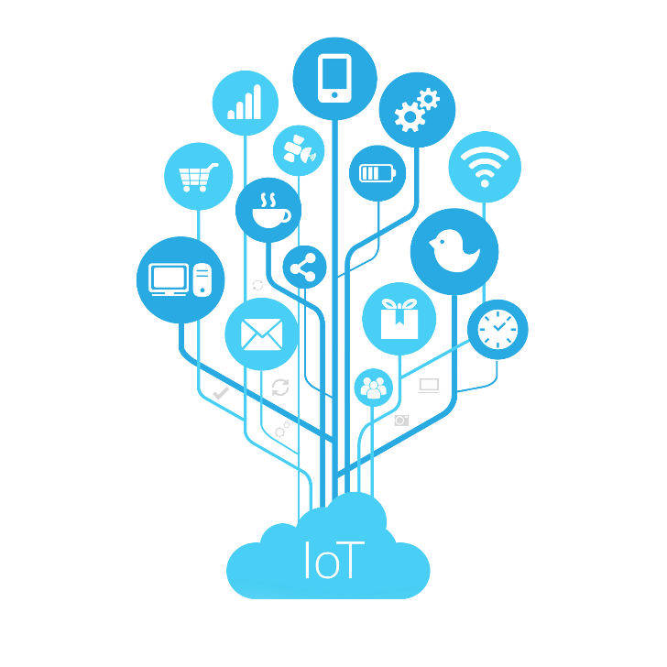
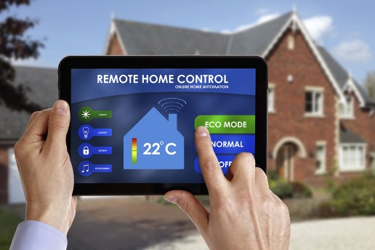
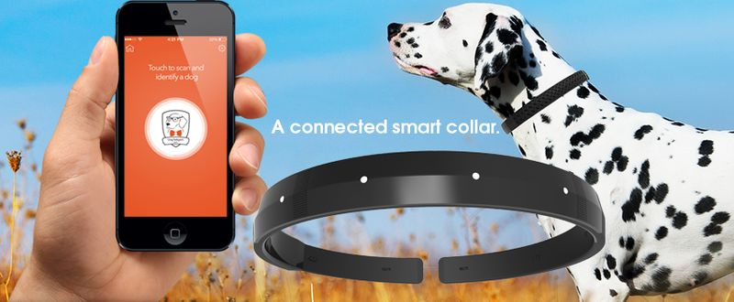
Disruption: Internet of Things
Making “dumb” devices “smart”
embed with sensors, software, network connectivity to enable collection and exchanging of data
Integration of physical world into virtual world
Smart shoes
Smart bike
Smart home
Smart pets

Slide 11
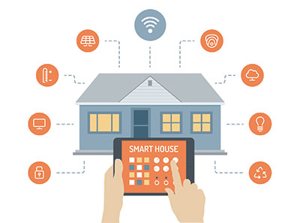
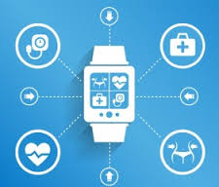
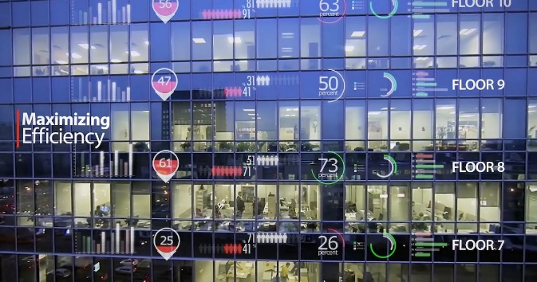
IoT: Industries
Home automation
e.g.: Smart light bulbs
Healthcare
e.g.: Fitbit activity trackers
Facilities management
e.g.: Sensing temperature, humidity of environment

Slide 12
IoT: Benefits
Receiving real-time information
Data analytics
Save time and resources by automation

Slide 13
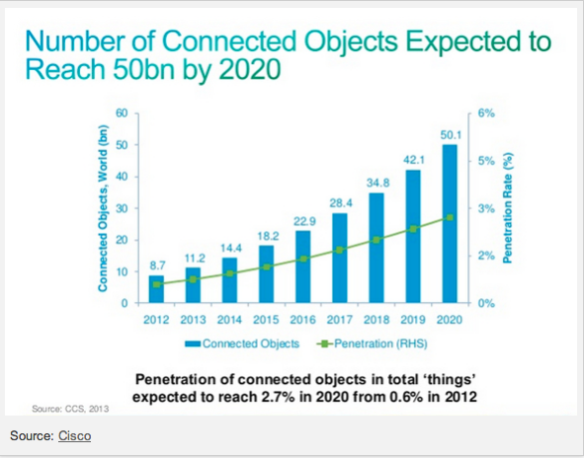
IoT Introduction
Interconnection (‘Internet’) between embedded devices with communication abilities (‘Things’)
Integration of physical world into virtual world
e.g.: Receive physical environment data from sensor in IoT and send data to computer system
Convergence of multiple technologies: Ubiquitous wireless connection, real-time analytics, machine learning, commodity sensors, embedded systems

Slide 14
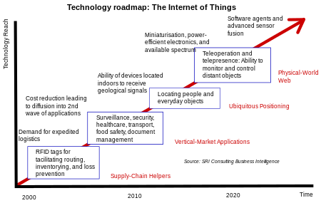
IoT Trend

Slide 15
IoT Controller: Characteristics
Connectivity: Able to communicate with another device, preferably using Bluetooth 5 with improved connectivity
Heterogeneity: Able to interact with other devices or service platforms through different network
Durability: Able to withstand physical environment conditions and long battery life
Physical safety: Hard to tamper device / damage users
Easy to program and deploy

Slide 16
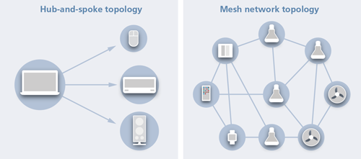
Bluetooth 5
Designed for IoT
Low energy (LE) – reduce power consumption
Uses mesh network topology – making IoT scalable, no need to worry about range of Bluetooth

Slide 17
Bluetooth 5 VS Bluetooth 4.2
Up to 2x bandwidth with low energy
From 1Mbps to 2Mbps
Up to 4x range with low energy
From ~80m to ~200m
Up to 8x broadcasting message capacity
From 31 bytes to 255 bytes
Interoperability improvement: communication between compatible profiles
Backwards compatible

Slide 18
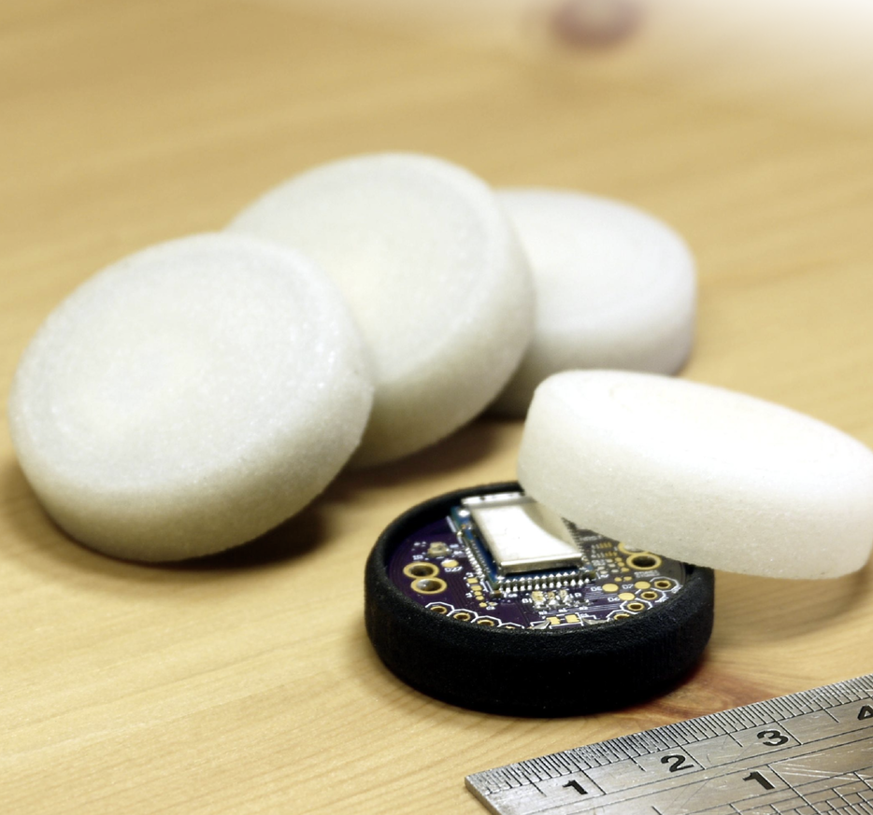
What is Puck.JS?
A programmable “button”
Contains many sensors, LEDs and GPIO pins
Supports Physical Web, Web Bluetooth, NFC,
Bluetooth 5 Ready
Open source
Basically a Compact, Cooler-looking Arduino Board + Sensors
https://www.kickstarter.com/projects/gfw/puckjs-the-ground-breaking-bluetooth-beacon

Slide 19
Open Source
Hardware, Software, libraries and documentation are all Open Source
Can replicate the design
Use cheaper hardware/manufacturers
Everyone can contribute
Report bugs and issues on the official forums.
The creator is very active in answering queries and suggest fixes for future patches
Weakness: Undocumented errors, Slow firmware update (dependent on one creator)
Notes:
Pls fill in this page thank you very much

Slide 20
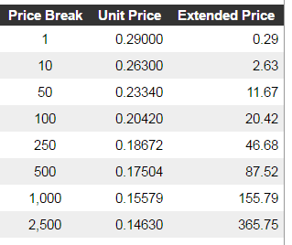
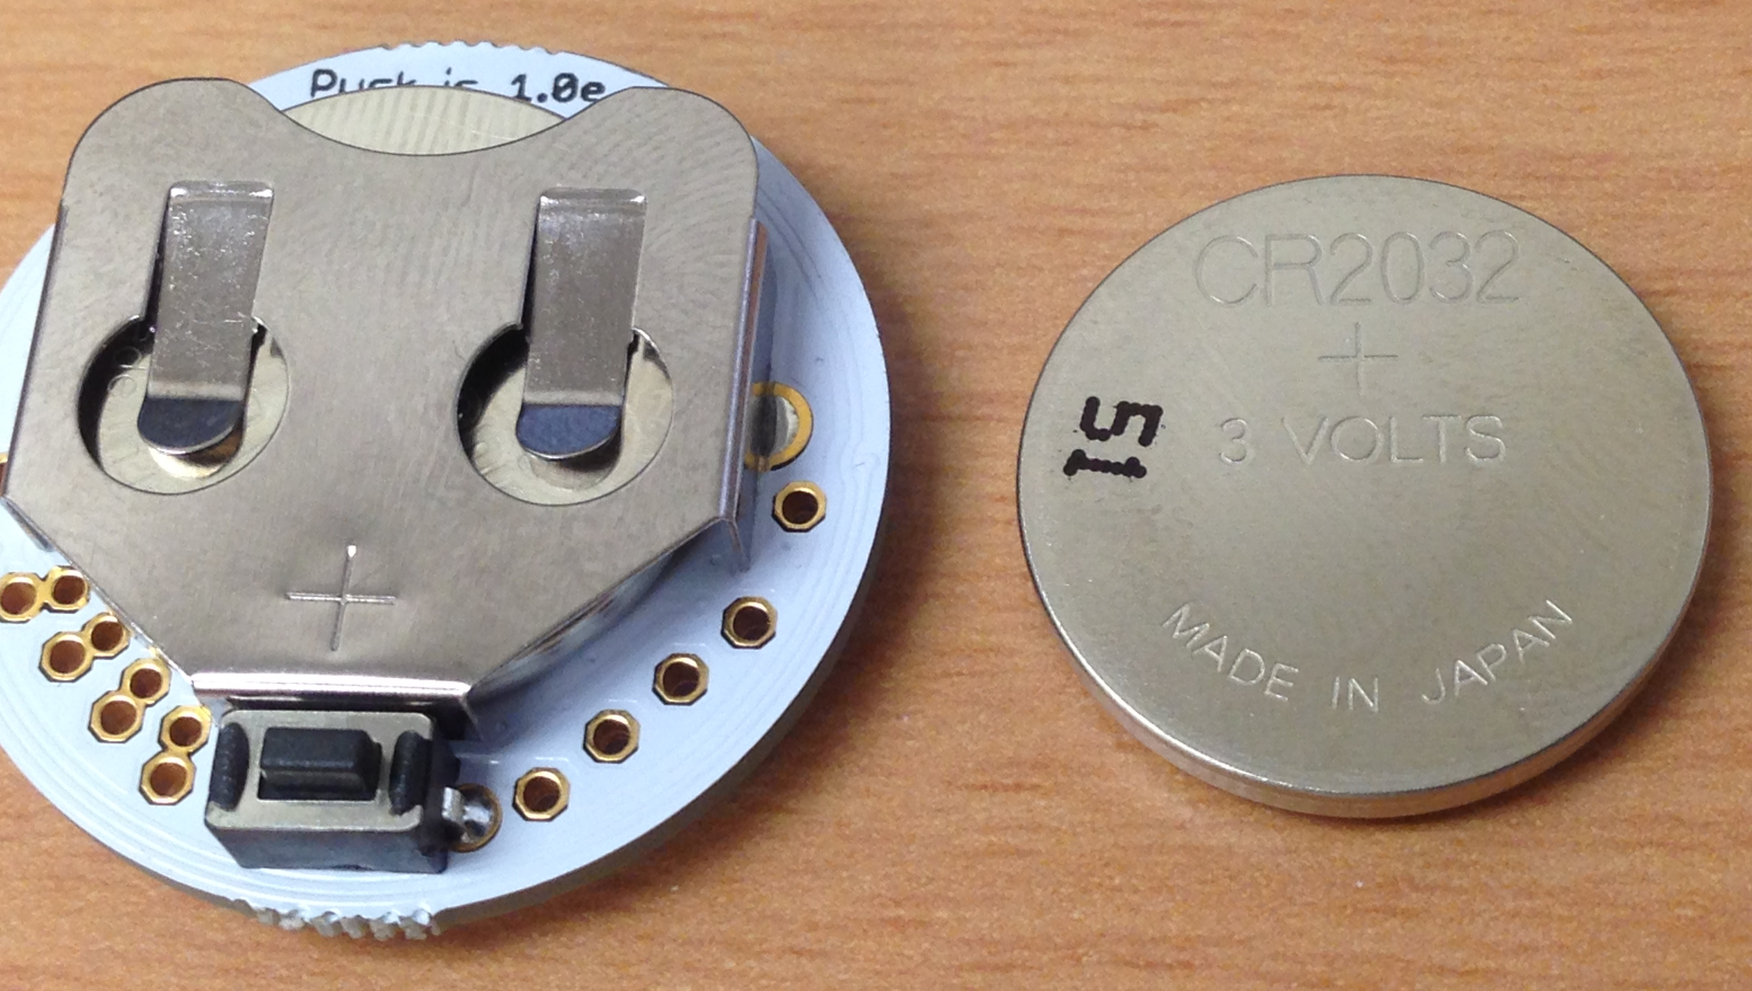
Cost
Puck.js: 39.95 USD
Battery
CR2032 (225mAh) (20mm)
Battery life:
Best Case
11250 hours = 1.3 years
(Basic advertising only, does not use sensors or LED)
USD
https://www.digikey.com/product-detail/en/panasonic-bsg/CR2032/P189-ND/31939

Slide 21
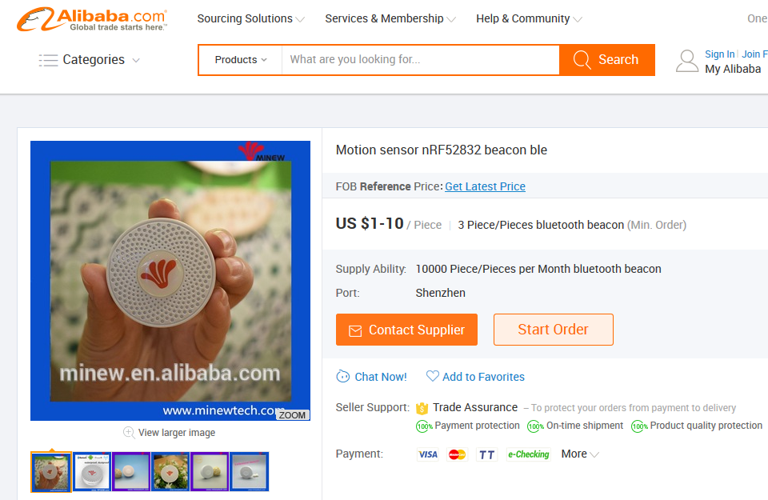
Cost – Other IoT beacons
Components could be bought cheaply if we are manufacturing in-house
Nordic nRF52832 module: US$0.1-0.2 (Alibaba)
http://www.alibaba.com/product-detail/Module-Bluetooth-4-2-NORDIC-NRF52832_60594820230.html?spm=a2700.7724838.0.0.Gfk9YD
Nordic nRF52832 beacon: US$1-10 (Alibaba)
https://www.alibaba.com/product-detail/Motion-sensor-nRF52832-beacon-ble_60410946591.html?spm=a2700.7724838.0.0.Gfk9YD&s=p

Slide 22
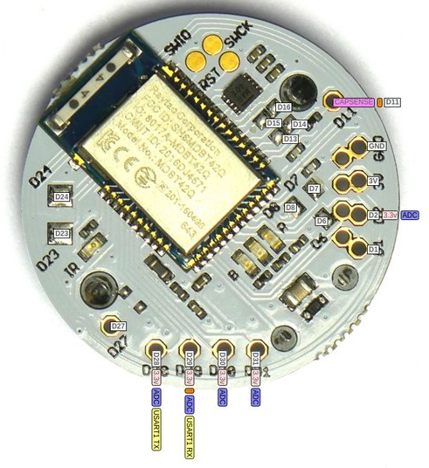
Sensors
MAG3110 Magnetometer
Infrared Transmitter
Thermometer
Light sensor
Battery level sensor
Capacitive sensing pin
NFC tag

Slide 23
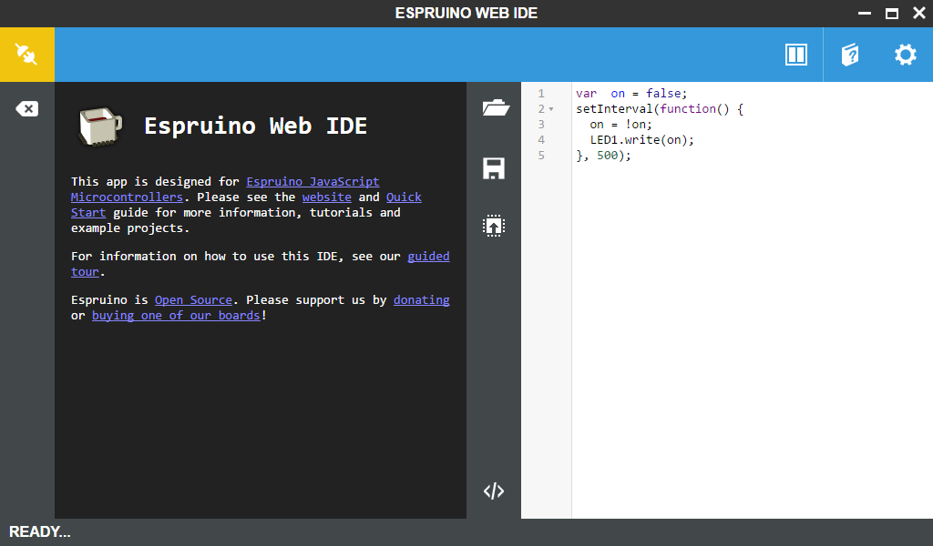
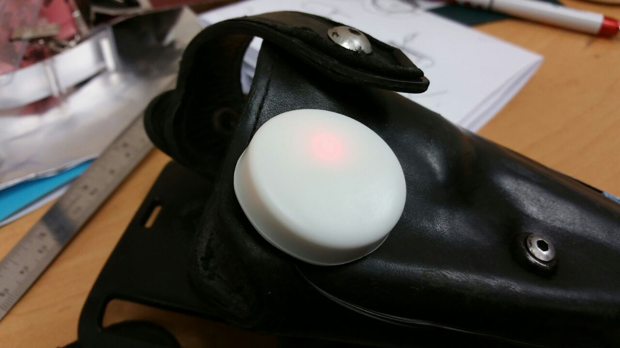
How It Works
1. Download Web IDE (Windows)
Chrome (Android)
2. Begin programming!

Slide 24
Requirements
No programming knowledge required – Graphic IDE Included
But basic knowledge in JavaScript recommended
Requires Bluetooth connection on the programming device
Windows – Install Web IDE
Android - Android 6 (Marshmallow) or later required
Android 5 works with latest Chromium build
Mac OS - OS X Yosemite above
Chromebook – all supported
Linux - BlueZ 5.41+ required

Slide 25
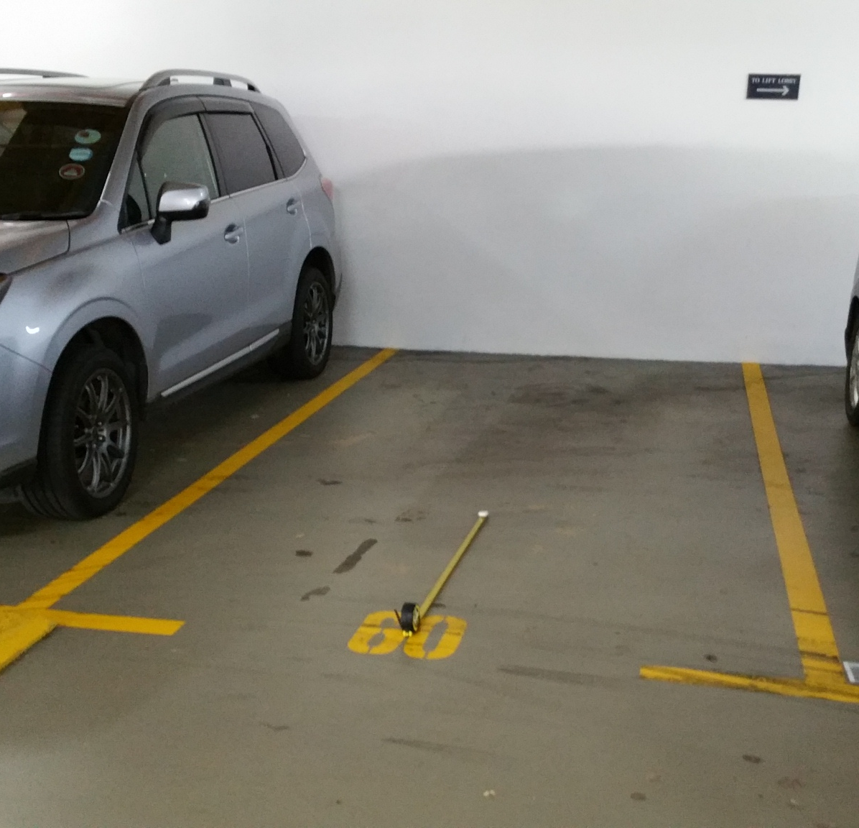
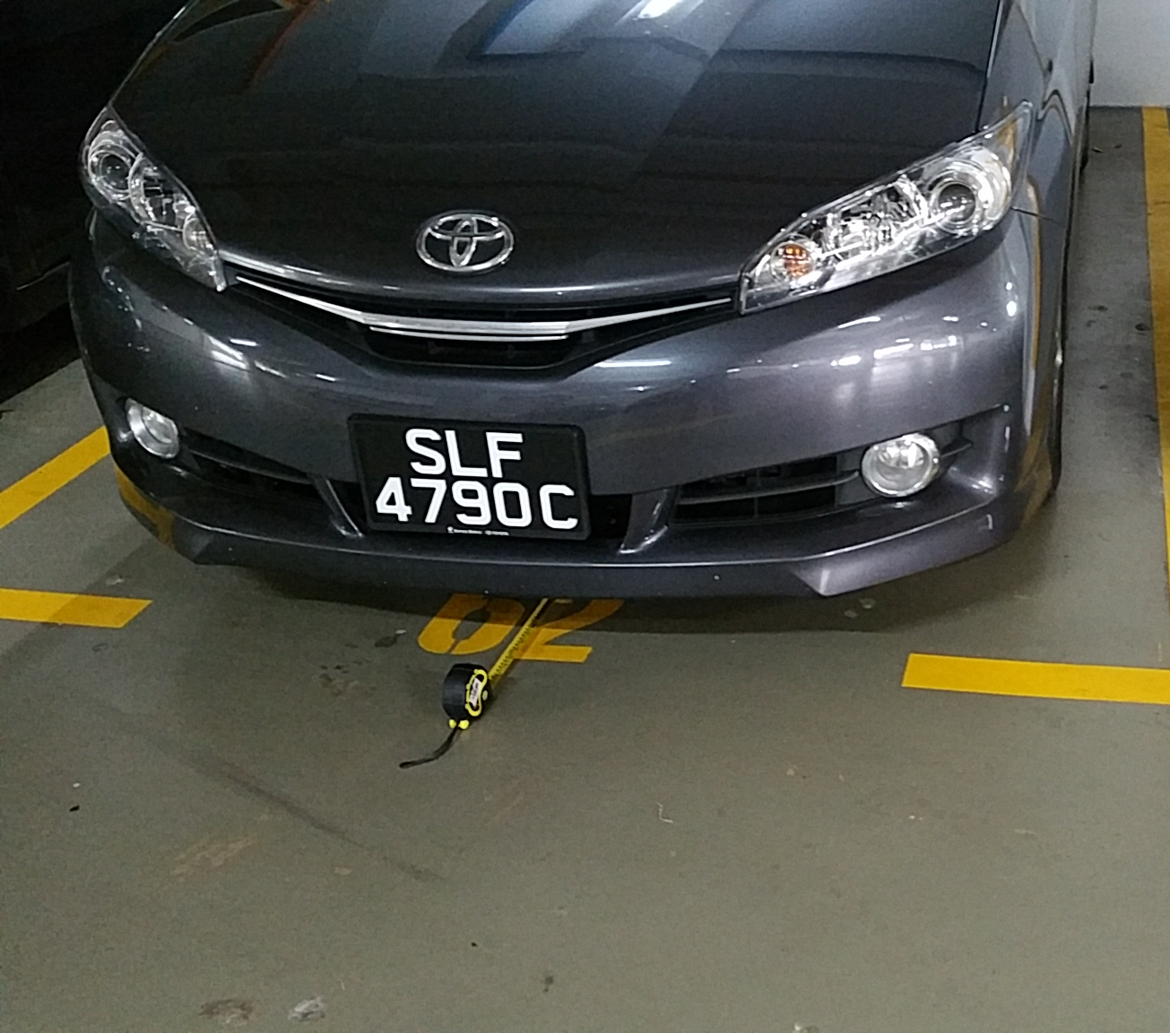
Overview - Magnetometer
Originally used as compass
Can be configured to use as a metal detector
Example: Use magnetometer to detect presence of car in parking lot
Notes:
+how the sensors work, no need emphasize the use cases

Slide 26
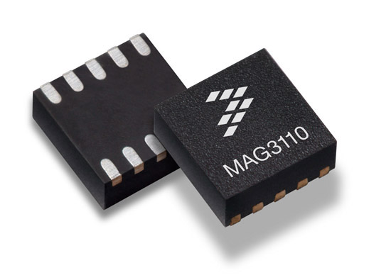
Overview - Magnetometer
Device which measures magnetic fields
Senses magnetic flux density → detects fluctuations in the Earth’s field
Vector magnetometer: measure flux density value in 3 dimensional space
Common application: compass, location tracking
Notes:
+how the sensors work, no need emphasize the use cases

Slide 27
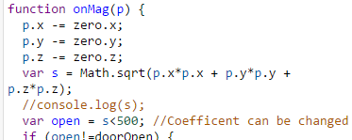
Overview - Magnetometer
Puck.mag() function returns the magnetometer reading in three dimensions (x, y, z)
Use root mean square function (RMS) to convert the reading into a more manageable form
Weakness: Moving the magnetometer will affect reading
Notes:
+how the sensors work, no need emphasize the use cases

Slide 28
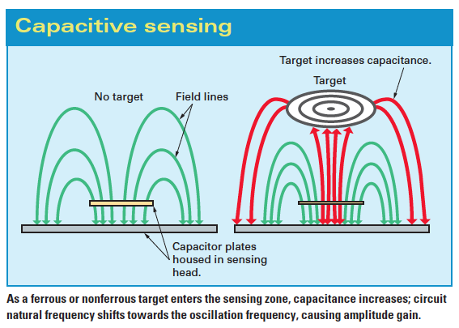
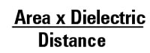
Overview – Capacitive Sensor
How it works: The capacitive sensor sense the change in capacitance in the surrounding area of the antenna, which is affected by the dielectric of the object nearby. (e.g. Dielectric of air < Dielectric of water)
Puck.js contains a capacitive sensing pin (D11).
Attach the pin to a large surface area using wire to increase sensitivity of sensing capacitance change.
Notes:
+how the sensors work, no need emphasize the use cases

Slide 29
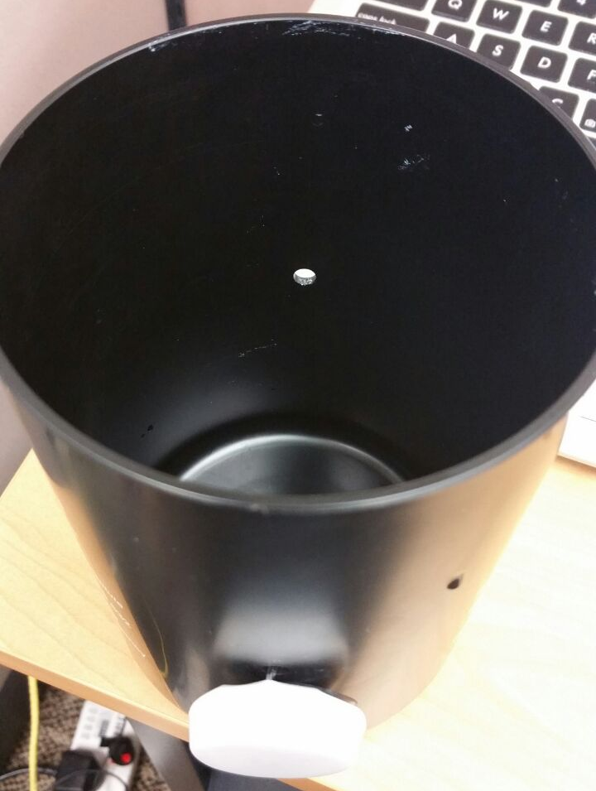
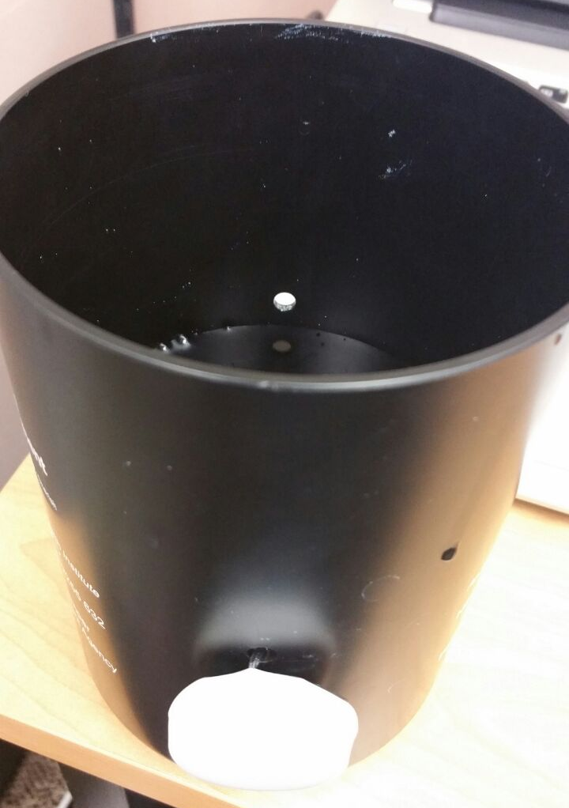
Overview – Capacitive Sensor
Able to sense the presence of liquid – use as water level sensor
Can tell difference between different water levels

Slide 30
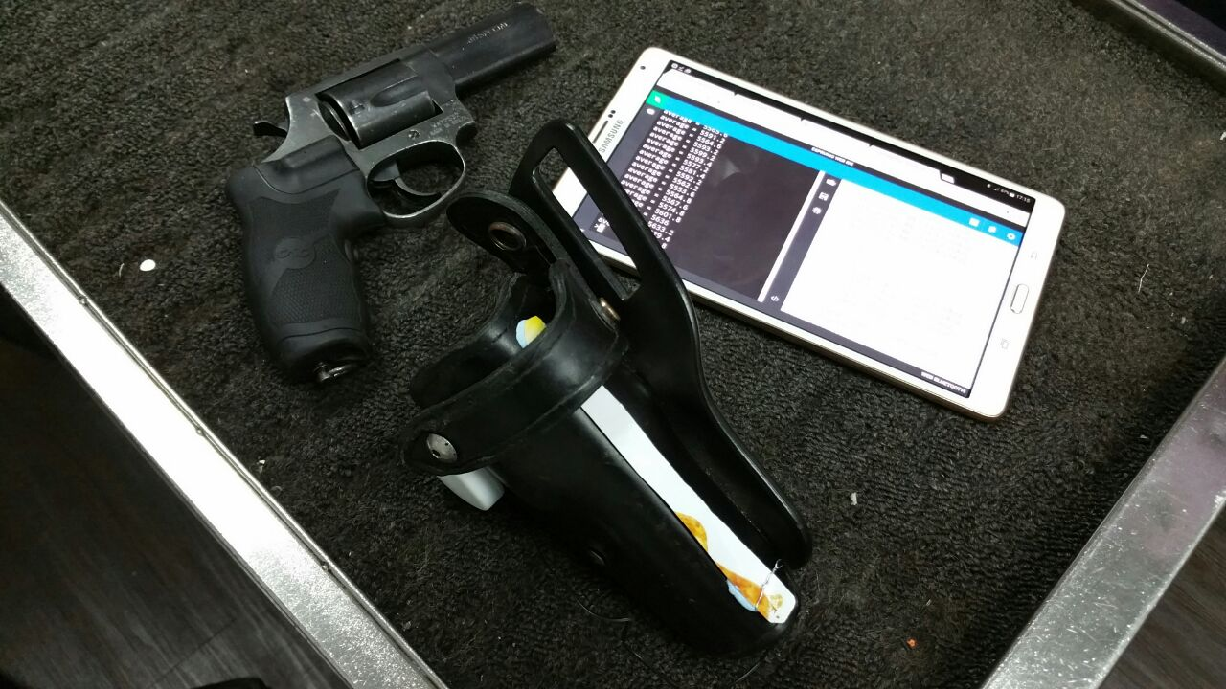
Overview – Capacitive Sensor
Able to sense the presence of solid – use as gun detector
Can tell difference between empty and full gun holster

Slide 31
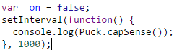
Overview – Capacitive Sensor
Puck.capSense() returns the capacitive sensor reading as an integer
Code below prints out the capacitive sensor reading every 1000ms/1s
Weakness: Needs an external antenna to extend the range, else it only uses the original pin which has extremely short range (<5mm)
Notes:
+how the sensors work, no need emphasize the use cases

Slide 32
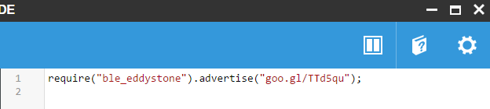
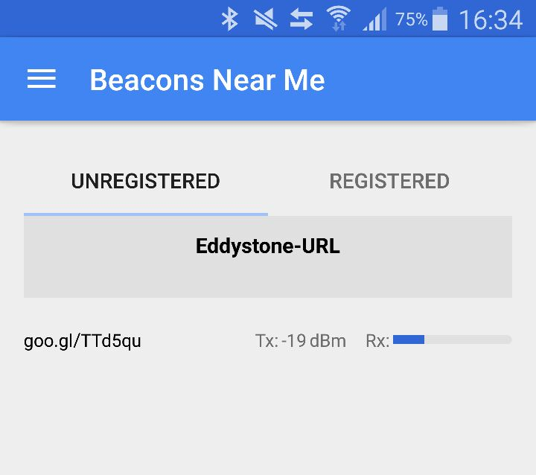
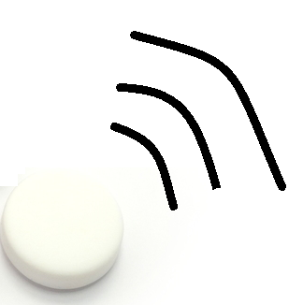
Overview – Bluetooth Beacon
Broadcast message using Bluetooth
Supports multiple formats e.g. Eddystone, iBeacon
On PC
Google Beacon Tools app on Android

Slide 33


Overview – Bluetooth Beacon
Broadcast message can be defined by user
URL
Battery Level
Sensor reading
etc.
Transmission power and rate can be configured
Maximum range: ~50m

Slide 34

Overview – Eddystone
Open BLE beacon format from Google
Part of Google beacon platform
Can be detected by both Android and iOS devices
Can broadcast different types of payload:
Eddystone-UID: unique and static ID
Eddystone-URL: compressed URL
Eddystone-TLM (telemetry): beacon status data, should be interleaved with UID/EID, encrypted eTLM version is available
Eddystone-EID: time-varying beacon frame, resolved to stable information by a linked resolver, such as Google Proximity Beacon API.
Puck supports Eddystone-URL

Slide 35
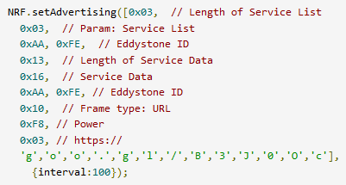
Overview – Bluetooth Beacon
Simple way:
require(“ble_eddystone”).advertise(“goo.gl/B3J0Oc”);
Another way:
NRF.setAdvertising(<data>, <options>)
Allows you to customize the data to be sent through Bluetooth
NRF.setTxPower()
Configure the transmission power (in units of dBm)
https://www.espruino.com/Reference#l_NRF_setAdvertising
Notes:
+how the sensors work, no need emphasize the use cases

Slide 36
Overview – Broadcasting
There are two types of Bluetooth broadcast that is supported by the Puck.js
Advertising
The Puck advertise a Bluetooth message, it might or might not have a receiver
Message can be read by all other beacons/Bluetooth scanners nearby
e.g. BLE Mesh
Pairing
The Puck searches for a receiver, establish a connection with it, then transmit the message
Can tell when the message is transmitted and received successfully (Using UART over BLE)
e.g. Puck to Puck communication
Notes:
+how the sensors work, no need emphasize the use cases

Slide 37
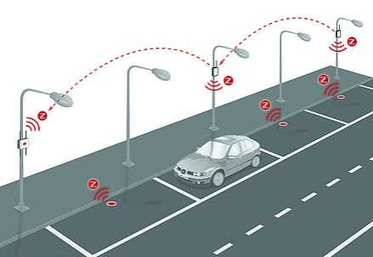
Overview – BLE Mesh
Puck can listen to other Bluetooth broadcasts nearby
Can act as a relay to increase the effective range of broadcast
Puck to Puck communication has been tested
Maximum range: ~10m (unobstructed)
Use case:
Puck broadcast sensor data
Sensor data read by nearby Pucks and rebroadcasted
Extend range + Ensure data gets to the intended recipient (e.g. a gateway)

Slide 38
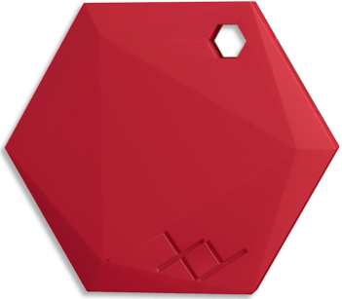
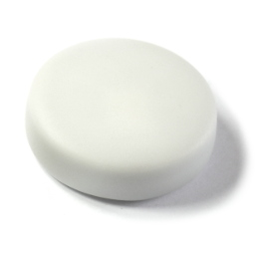
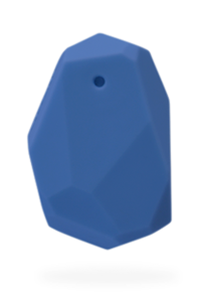
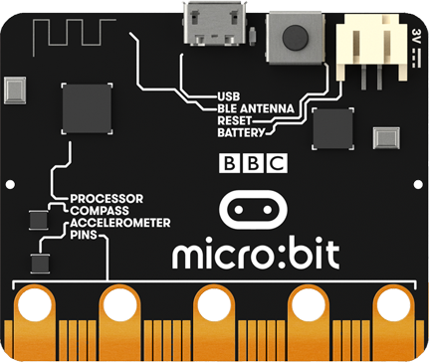
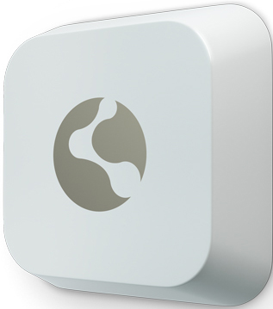
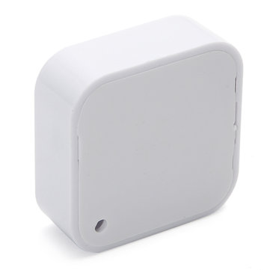
Overview – Bluetooth Mesh
Connection between three IoT controllers possible
Able to expand to much more IoT controllers in the future
Notes:
+how the sensors work, no need emphasize the use cases

Slide 39
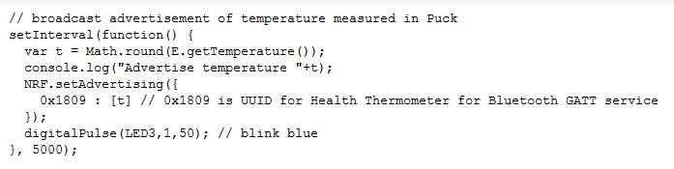
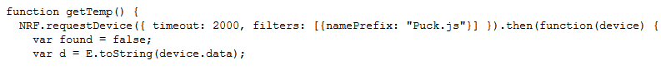
Overview – Bluetooth Mesh
Puck #1
Puck #1 broadcast temperature data (using NRF.setAdvertising())
Puck #2 will scan for Bluetooth broadcast from Puck #1. If found, it will rebroadcast the same temperature data
When the micro:bit detects the temperature data, the LED on board will turn on.
Note: only Puck #1 and #2 requires programming beforehand, the micro:bit does not contain any preloaded code
Puck #2
Micro:bit
Notes:
+how the sensors work, no need emphasize the use cases

Slide 40

Overview – Puck to Puck Comm.
The sender Puck can scan all nearby Bluetooth devices and filter out the devices you want to connect to.
No prior configuration on the receiving Puck is required
But if specific user defined functions is required, need to define on receiving Puck first
E.g. the rebroadcast() function in the picture below
Notes:
+how the sensors work, no need emphasize the use cases

Slide 41
Overview – Other Features
Light Sensor
Measure the “brightness” of the environment around the Puck
Temperature Sensor
Measure surrounding temperature
NFC (Near Field Communication)
Broadcast any data, can be received by NFC-enabled phones
IR (Infrared)
Act as a controller, can be used as a power on switch
GPIO Pins, LED and Button
GPIO Pins capable of PWM, SPI, I2C, UART, Analog Input
Three LEDs for indication or alert purposes
Push button can be used for user input

Slide 42

Overview – Update Firmware
Update using nRF Toolbox App (Android & iOS)
Download the binaries from the official site
Reset the Puck and boot it in debug mode
Upload the firmware to the Puck using the app
Puck.js is still actively developed – firmware updates to provide new functions are released occasionally
Potential BLE5-supporting firmware

Slide 43


PC
Hands on (1)
Materials:
Tablet with Web Bluetooth enabled/PC
Puck.js
Steps (For Tablet):
Open Chrome Web Browser on the tablet
Navigate to http://www.espruino.com/ide/
Connect to the Puck by clicking the top left button (Yellow)

Slide 44
Hands on (PC-1)
For Windows user
Steps (For PC):
For PC, go to goo.gl/uK7Fz1 and install the Web IDE
Connect the Puck to your PC (Through Bluetooth options)
Connect to the Puck by clicking the top left button in the IDE (Yellow)

Slide 45


Hands on (2)
Steps:
4. Click the “Upload code” button
5. The red LED on the Puck should be blinking now

Slide 46




Training Codes:
goo.gl/YG165W
Hands on (3)
There are several codes preloaded in the tablet to showcase the sensors
Feel free to try them out!

Slide 47
Training Codes:
goo.gl/YG165W
Hands on (4)
Training_LED.js
Use the button to turn the LED on and off
Training_Magnetometer.js
Turn on Green LED when metal is close by (e.g. scissors/some smartphones)
Training_capSense.js
Turn on Red LED when a finger is placed on D11
Training_Puck2Puck_Master.js
Training_Puck2Puck_Slave.js
The Master Puck can control the Slave’s LED
Notes:
Bluetooth mesh, puck to puck, tx power, rate, firmware update

Slide 48
Training Codes:
goo.gl/YG165W
Hands on (5)
Training_Light.js
Turn on the LED when dark (cover the Puck with your fingers)
Other individual instructions
digitalWrite(LED1, 0) – LED1/2/3, 0/1
E.getTemperature – get temperature in C
Puck.getBatteryPercentage()
Puck.light() – light sensor
Puck.mag() – get magnetometer reading (x,y,z coordinates)

Slide 49
Training Codes:
goo.gl/YG165W
Exercise
What does this code do?
Setup
Download Exercise.js from the site above, fill in the blanks.
Press the button.
What does this function do?

Slide 50
Conclusion
Some considerations:
Inconspicuous / size
Range
Bluetooth Mesh support
Battery Life
Open source hardware design means we can replicate the design and manufacture ourselves to reduce cost
Other Bluetooth beacons can be used as substitute
More testing required

Slide 51

Thank You

Slide 52
References
IoT_Innovation – Puck.js – Part 1.pptx (Lee Han Cheng)
IoT_Innovation – Puck.js – Part 2.pptx (Dinh)
[PPT] NEA Gravitrap Water Level Sensing Project.pptx (Ting Yi)
https://www.espruino.com/Puck.js

